Slide 1
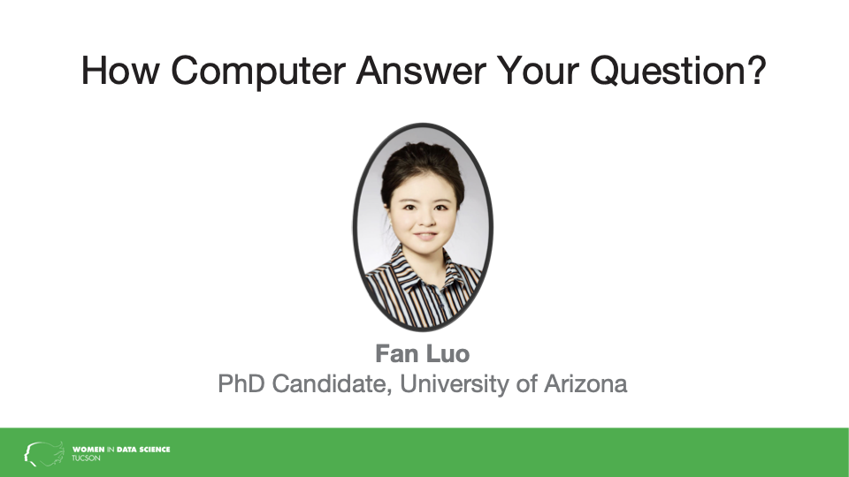

Slide 2

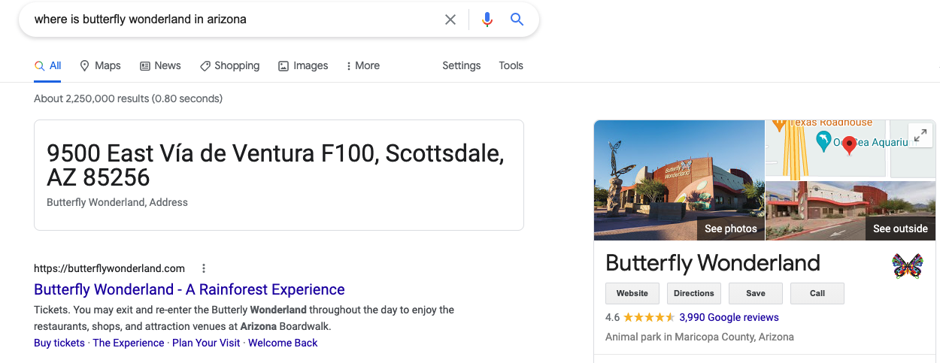
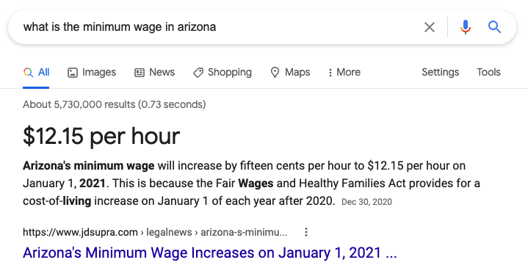
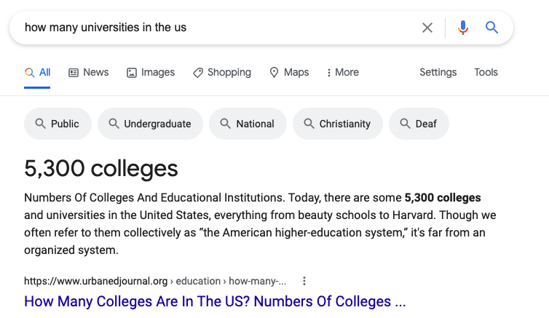
Question Answering System
Illustration by Freepik Storyset
Notes:
Information overload exceeds the human capacity to aggregate and interpret the fragments
of knowledge published in millions of articles per year. Natural Language Processing (NLP)
techniques convert text to information could be effectively harnessed by computer systems,
raising information access to a higher level to better serve information needs. By and large,
information needs appear as questions. People ask a question and get the answer back, and
it is one of the most common ways to acquire new knowledge. QA systems reply a question asked in natural language (For example: How many universities in the US?") with the precise answer (53,00) There are also other applications of QA systems such as: virtual assistants (e.g.: chatbot, virtual custom service)

Slide 3
Question Answering System
Information retrieval-based QA
Knowledge-based QA
Language Model-based QA
Illustration by Freepik Storyset

Slide 4

Information retrieval-based QA
▶️
Given a user question: 1. Information retrieval is used to find relevant passages
Map queries and document to vectors
Use cosine similarity to rank candidate documents
2. Reading comprehension draw an answer from spans of text
For each token in the passage, compute two probabilities: P_start, P_end
The answer can be chosen as the span with the highest probability.
Notes:
▶️ Information retrieval-based question answering
Given a user question: 1. information retrieval is used to find relevant passages.
A user poses a query to a retrieval system, which then returns an ordered set of documents from document some collection.
A document refers to whatever unit of text the system indexes and retrieves (web pages, scientific papers, news articles, or even shorter passages like collection paragraphs).
The basic IR architecture map queries and document to vectors, and use the cosine similarity between the vectors to rank candidate documents.
tf-idf, dense
As a result, retrieve relevant passages from a text collection. 2. Then neural reading comprehension algorithms read these retrieved passages and draw an answer directly from spans of text. For each token pi in the passage, compute two probabilities: pstart(i) that pi is the start of the answer span, and pend(i) that pi is the end of the answer span. The answer can be chosen as the span with the highest probability.
▶️ Knowledge-based question answering
While an enormous amount of information is encoded in the vast amount of text on the web, information obviously also exists in more structured forms. For example, datasets consist of a set of facts in the form of triples.
subject predicate object Ada Lovelace birth-year 1815
This triple can be used to answer text questions like “When was Ada Lovelace born?” or “Who was born in 1815?”.

Slide 5
Knowledge-based QA
▶️
subject | predicate | object
Ada Lovelace | birth-year | 1815
... | ... | ...
1. Graph-based QA
- Knowledge base as a graph - Relation detection and mapping - Search and rank triples
2. QA by semantic parsing - Map the question to logical form
- Use a query language like SQL or SPARQL
What is the largest state? argmax(λx.state(x),λx.size(x))
Notes:
▶️ Knowledge-based question answering
While an enormous amount of information is encoded in the vast amount of text on the web, information obviously also exists in more structured forms. For example, datasets consist of a set of facts in the form of triples.
subject predicate object Ada Lovelace birth-year 1815
This triple can be used to answer text questions like “When was Ada Lovelace born?” or “Who was born in 1815?”. 1. Graph-based QA
knowledge base as a graph
entities as nodes
relations or propositions as edges
relation detection
relation linking: computing similarity “When was Ada Lovelace born?” → birth-year (Ada Lovelace, ?x)
Ranking of answers: Most algorithms have a final stage which takes the top j entities and the top k relations, searches the knowledge base for triples containing those entities and relations, and then ranks those triples.
2. QA by semantic parsing Get a set of questions paired with their correct logical form, train a system that maps from questions to their logical forms.
A common baseline algorithm is a simple sequence-to-sequence model, for example using BERT to represent question tokens, passing them to a biLSTM encoder decoder.

Slide 6
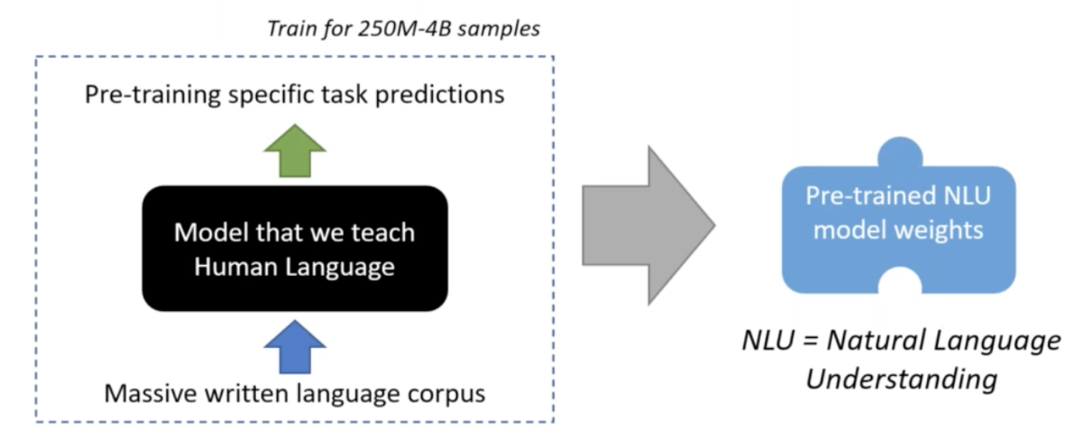
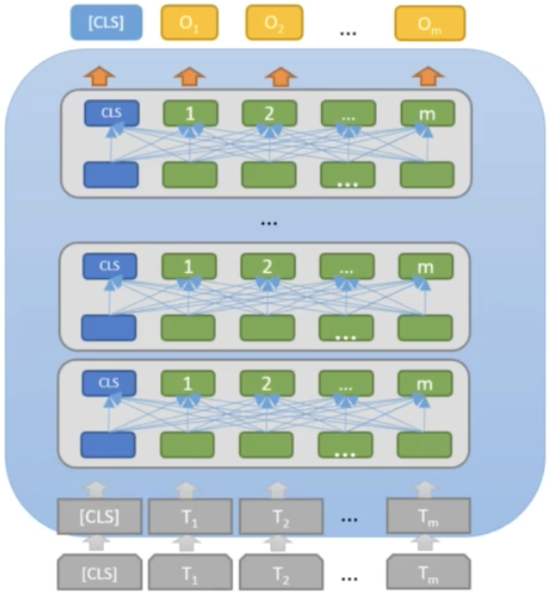
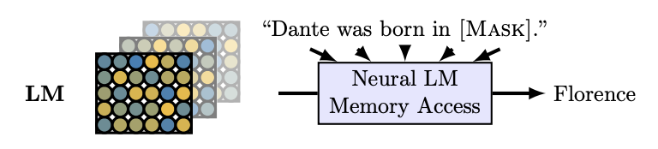
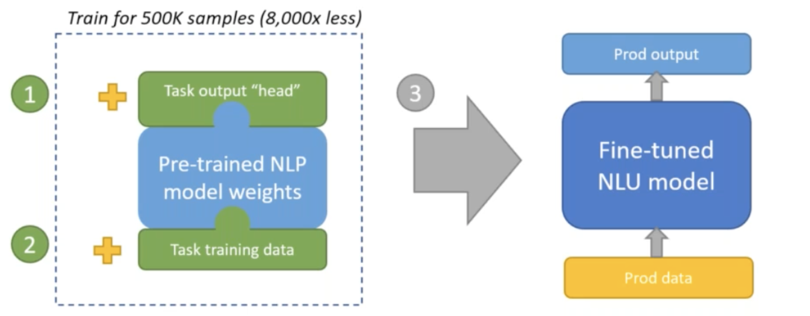
Language Model-based QA
▶️
__
Bring power of transformer models to semantic search in Azure Cognitive Search, Alec Berntson
Notes:
Query a pretrained language model, forcing a model to answer a question solely from information stored in its parameters.
pretrained to fill in masked spans of task.
Language modeling is not yet a complete solution for question answering: - in addition to not working quite as well, - they suffer from poor interpretability, they currently can't give users more context by telling them what passage the answer came from.

Slide 7

Jupyter Notebooks
CoreNLP, Spacy
NetworkX
Hugging Face
Pytorch-Lightning
Notes:
NetworkX is a Python package for the graph creation and computation
models directly from Hugging Face infrastructure and run large scale NLP models

Slide 8
References
Jurafsky, Daniel, and James H. Martin. "Speech and Language Processing: An Introduction to Natural Language Processing, Computational Linguistics, and Speech Recognition." Petroni, Fabio, et al. "Language models as knowledge bases?."

Slide 9
Thank You

